Slide 1
Children’s Message:
“Workers in God’s Harvest”

Slide 2
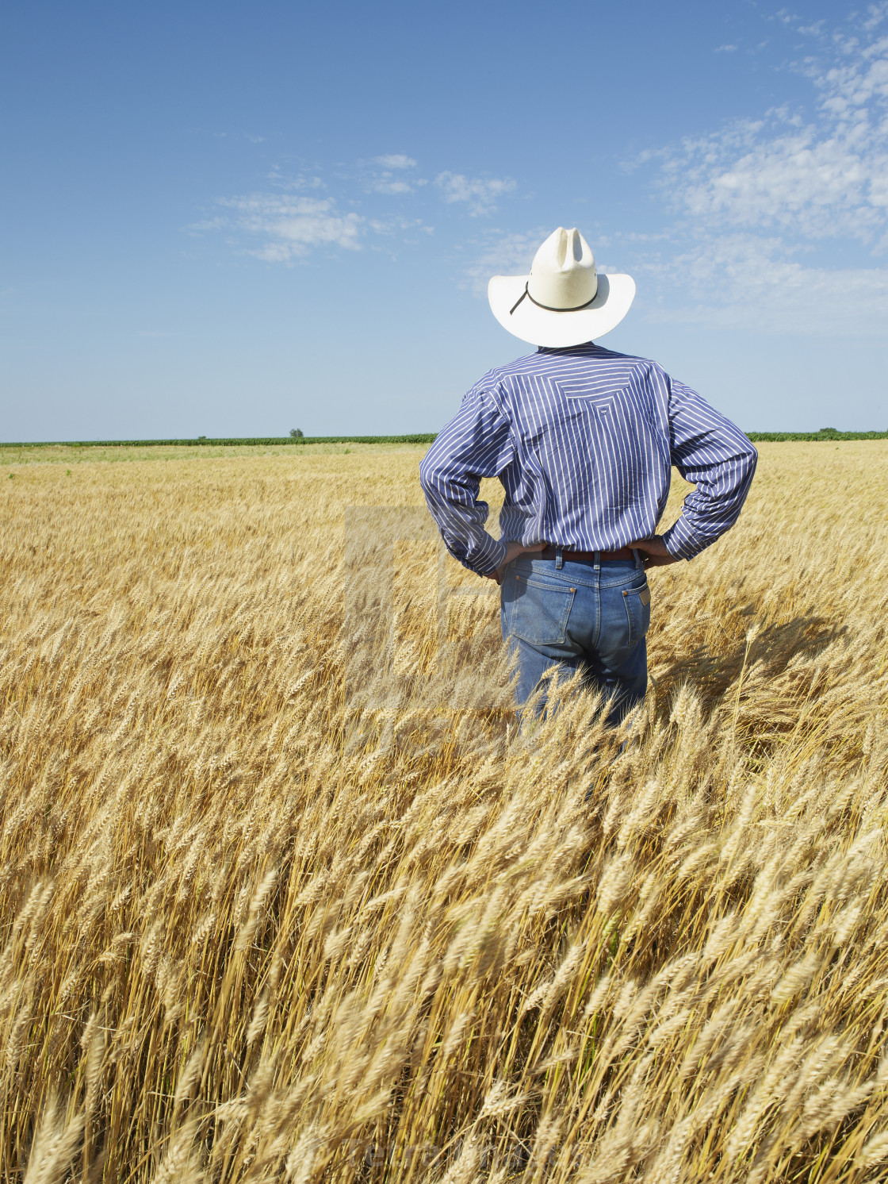
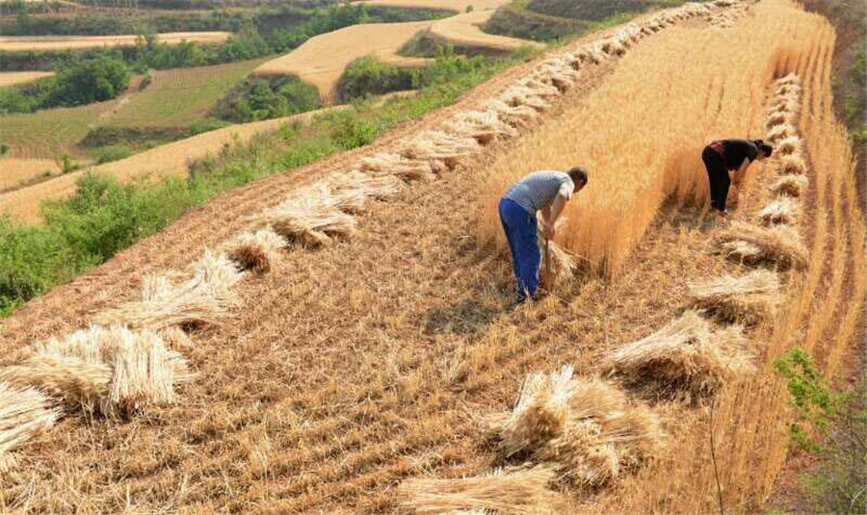
The Harvest
2. The Workers
3. Lord of the Harvest

Slide 3
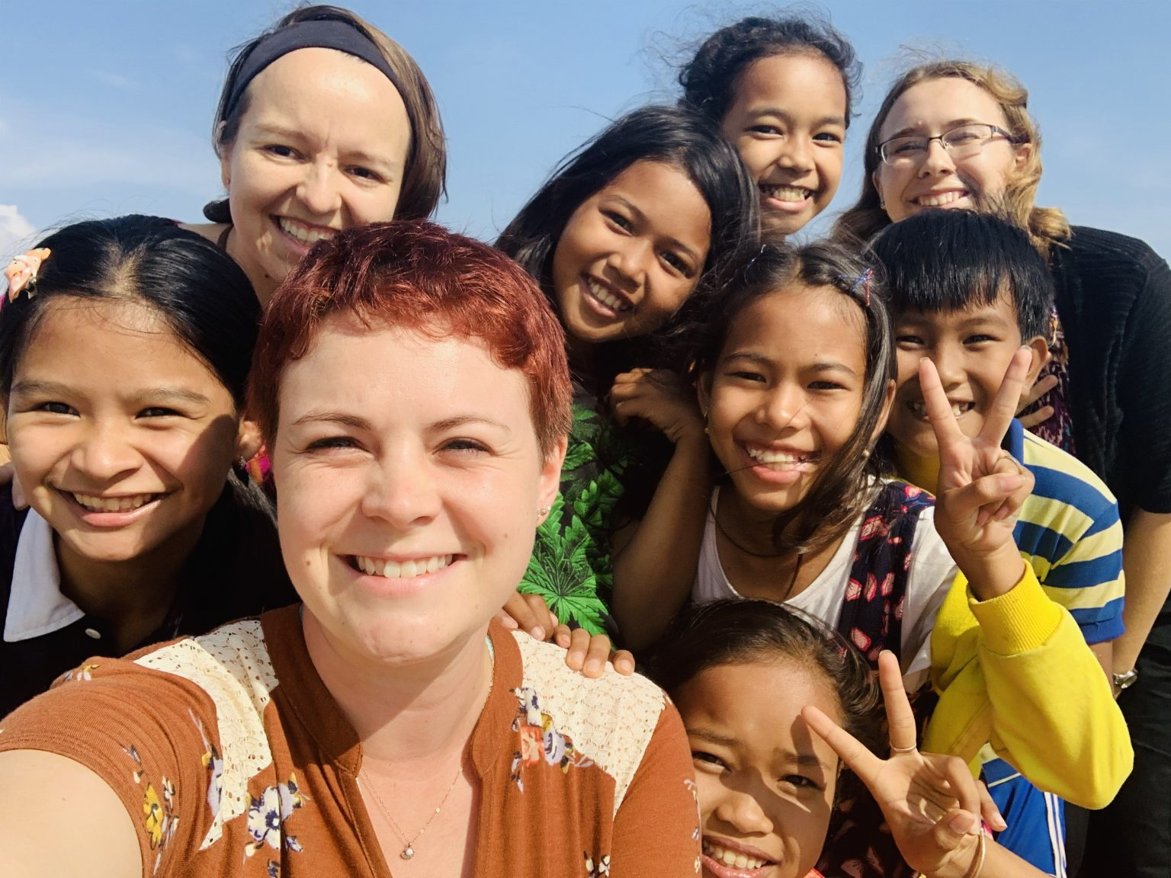
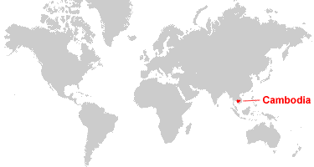
Sam, Maria and Ashley
Workers in Cambodia

Slide 4
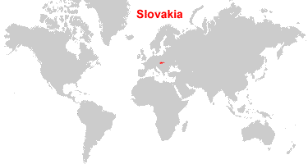
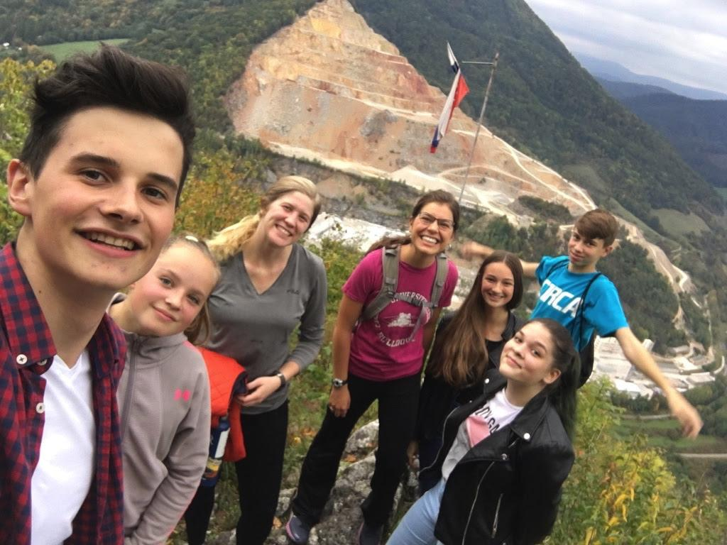
Clara and Anastasia
Workers in Slovakia

Slide 5
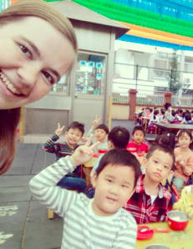
Sarah
Worker in Taiwan

Slide 6
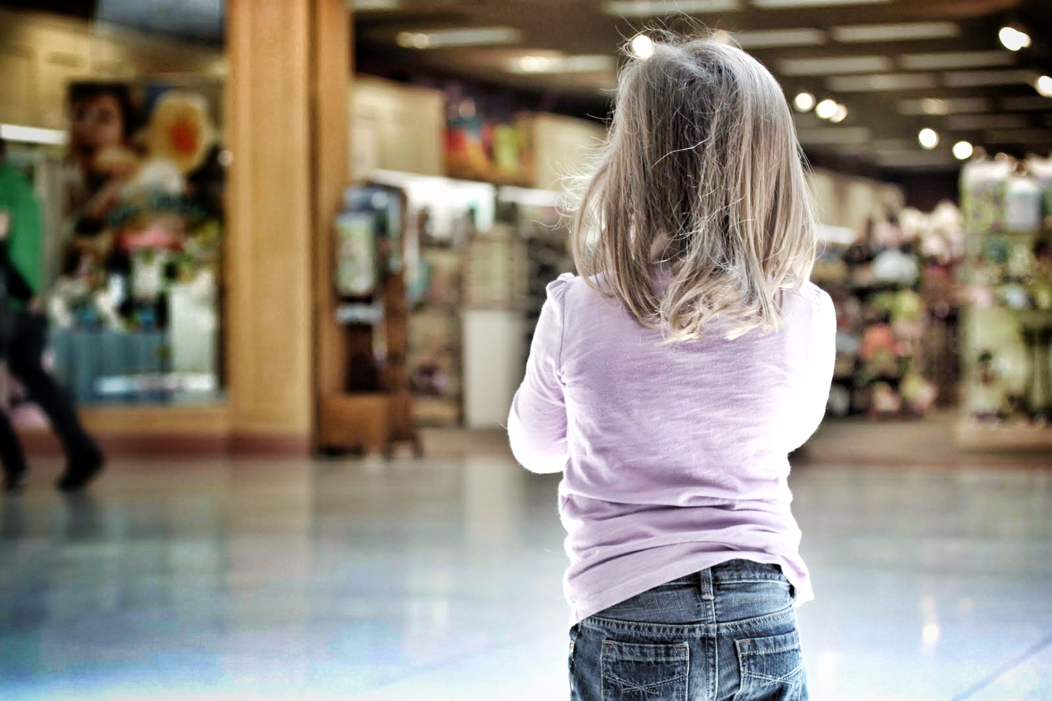
Children’s Message:
“Lost Children”

Slide 7
“Ask the Lord of the harvest to send out workers into His harvest field.”

